Slide 1
IMDB MOVIE ANALYSIS
Final Project-1

Slide 2
Description
This is data analytic project of IMDB movies. I completed the following task as leading team provided me by using my data analytics skills in excel. The tasks which I needed to complete are following:
Clean the data and make it more understandable and readable for better analyzing.
The movies with highest profits.
The top 250 IMDB movies according to user ratings
The top 10 directors for whom the mean of imdb_score is the highest and store them in a new column top10director.
The most popular genre of movies
The actors who is more popular in both critics audiences.

Slide 3
Approach:
I started my homework my learning more about excel analysis and how can I perform the necessary function according to the need of analysis. Then I started understanding the given dataset and tried to find the pattern or anything which can help me in cleaning the data. The I started my actual work my cleaning the dataset by performing certain steps and then started my analysis for given tasks.
Tech-stack used:
I used the window version of Microsoft excel.
Insights:
I used many excel functions and got to know more about excel features. I got more Insights on the project, like how can I perform same analysis with different tools and features in the excel and how it can be more understandable by doing different analysis.

Slide 4
Cleaning the data
I started my data cleaning by firstly understanding the pattern
I removed all the rows which contain empty or null columns.
I removed all the duplicate rows.
I removed the column which was not necessary during the main analysis.
I changed the column size and format, to make it more understandable and readable.
I arranged the column in the way which make it more readable and finding
connection between columns.

Slide 5
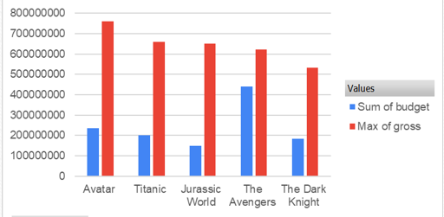
Movies with highest profit

Slide 6
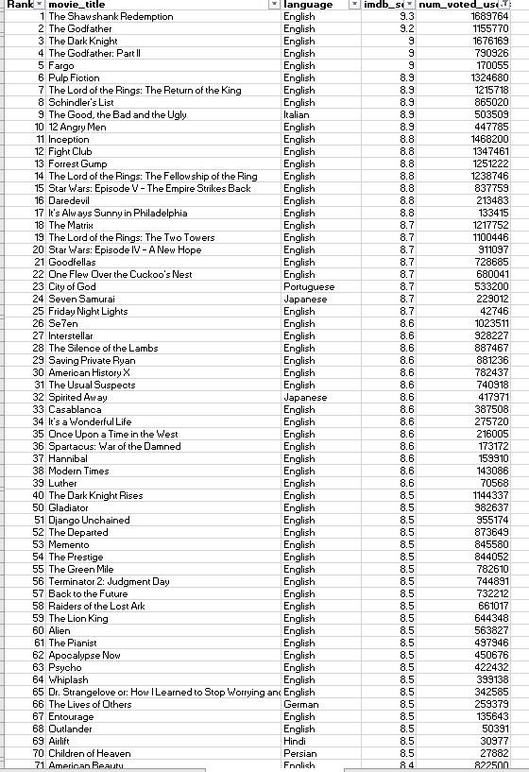
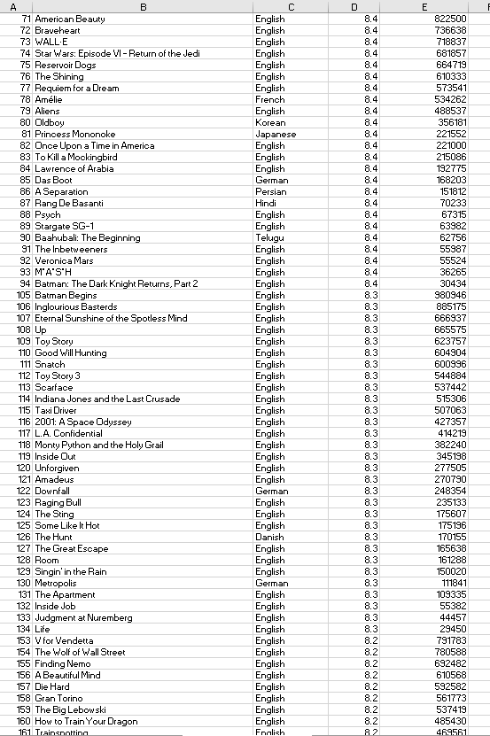
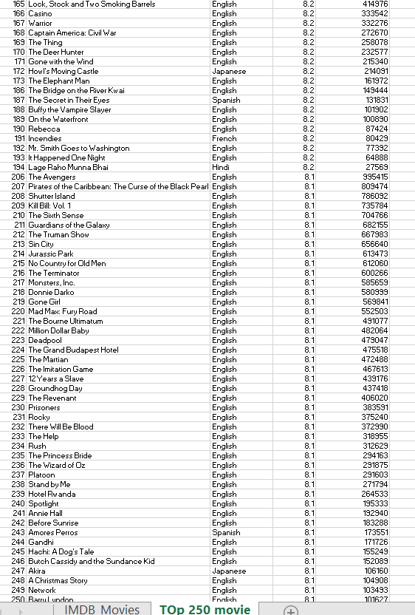
Top 250

Slide 7
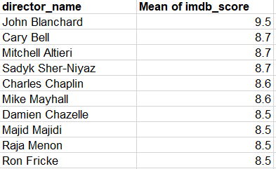
Best Directors

Slide 8
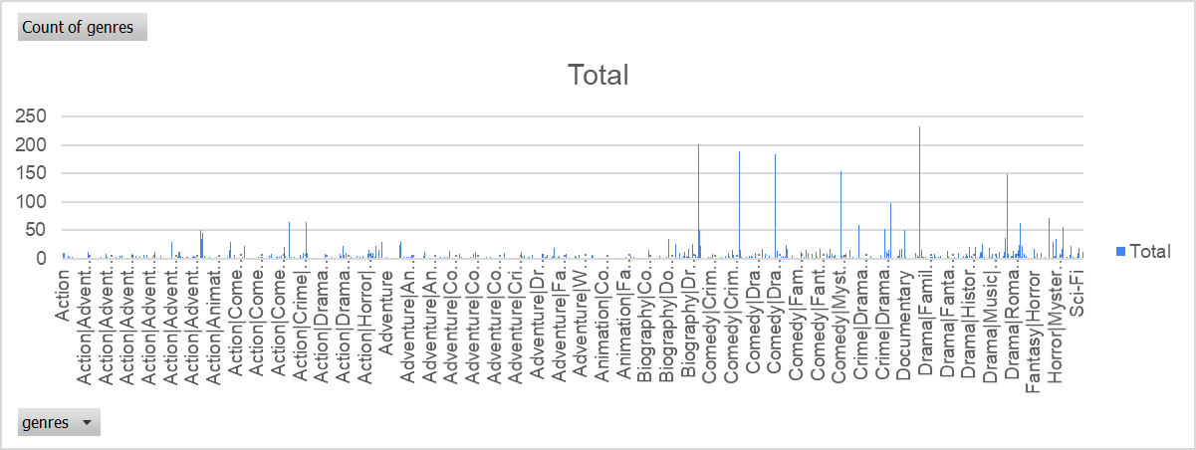
Popular Genres

Slide 9
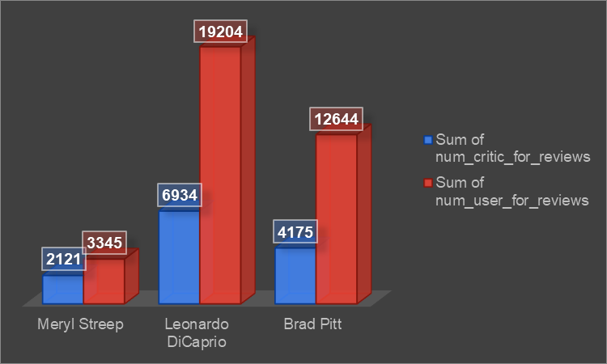
Charts

Slide 10
Result
By completing the project, I am feeling more confident in my Excel knowledge. It really helped me to brush up on my concepts related to mean and Averageif functions. It also helped me to understand the pivot table and how to clean data can better help to understand the data.
Project Done by
Kaviya

